Slide 1


Notes:
1

Slide 2


Da li je nešto novo u Oracle Supportu?
Slavko Rožič
Support Director

Slide 3



Agenda
Oracle Services overview
Oracle Support major functionalities
News in Oracle Support

Slide 4





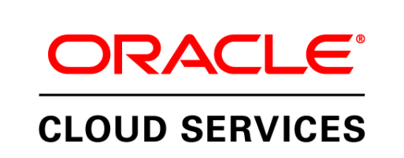
Oracle Lifecycle Services
Transforming your Business
Using Oracle Solutions
Complete Support for Oracle Software, Hardware, Engineered Systems
Mission Critical Support Services for All
Oracle Applications and Technologies
Your Complete Training Source for
Oracle Software and Hardware
The Power of Oracle in the Cloud
Notes:
4

Slide 5



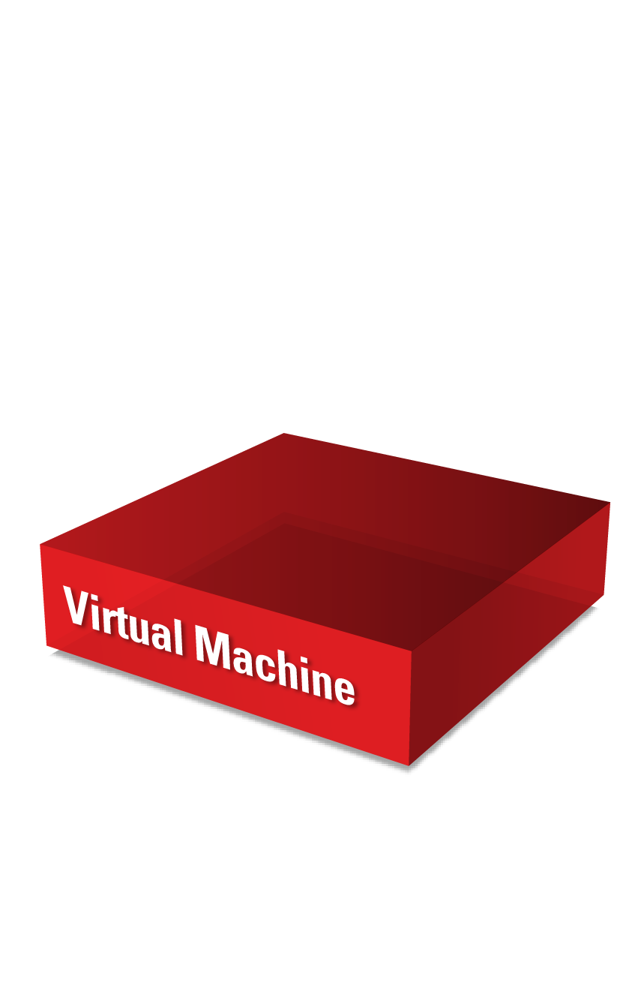
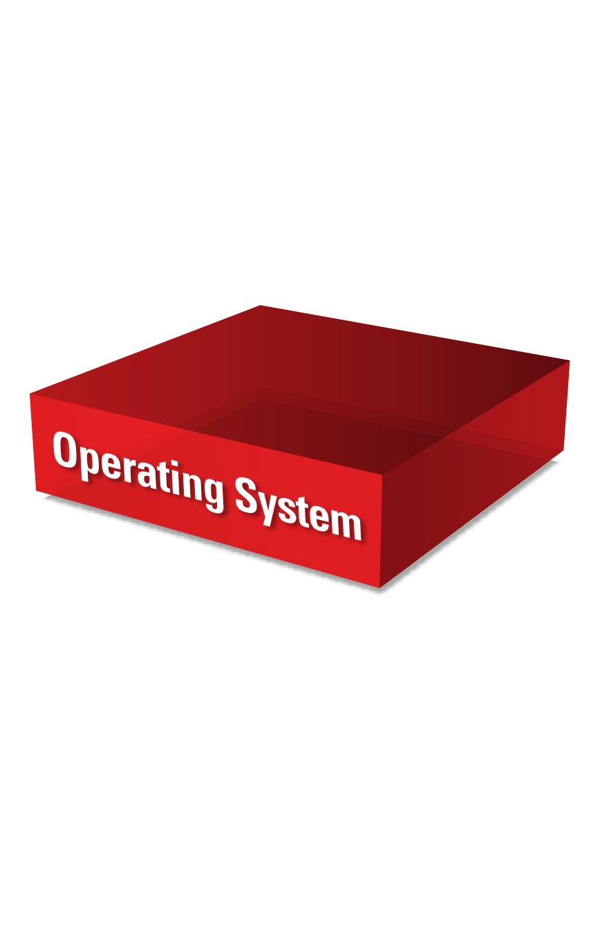
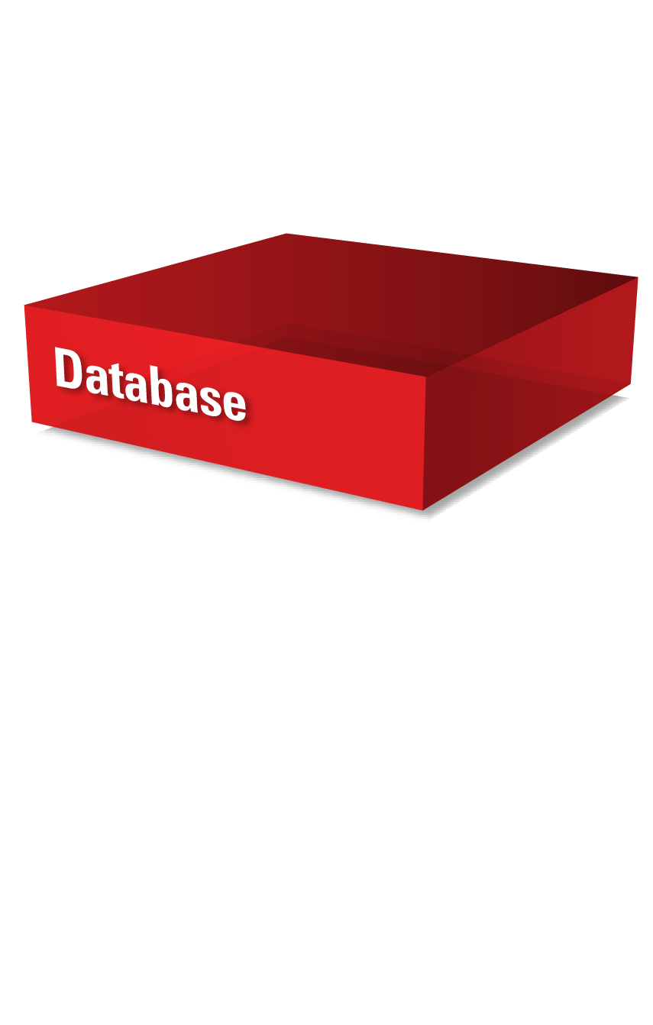


Where Do You Want to Go?
On Premises
(IaaS)
Private
Cloud
Managed
Cloud Services
Oracle
Cloud
5
Notes:
Oracle offers a complete technology stack -- from applications, middleware, database, and OS, to virtual machines, servers and storage. Today that stack includes 4000 unique Oracle products. And the stack becomes increasingly valuable, as customers invest in more parts of the stack to solve their technology challenges.
Most of you are here because you’re planning, or are in the midst of strategic IT initiatives
Maybe you’re considering:
Cloud Computing and one of its many varied deployment options – Public cloud, private cloud, managed cloud services
Data Center Refresh/Data Center Optimization
A new Customer Experience or Business Analytics solution
Typical questions many of you are asking:
How can I adopt Oracle technology quickly, efficiently?
What will it cost?
How much risk?
How quickly can I architect a new solution-and can I get it done right the first time?
When will I achieve return on my technology investment?
That’s where Oracle Services comes in.

Slide 6


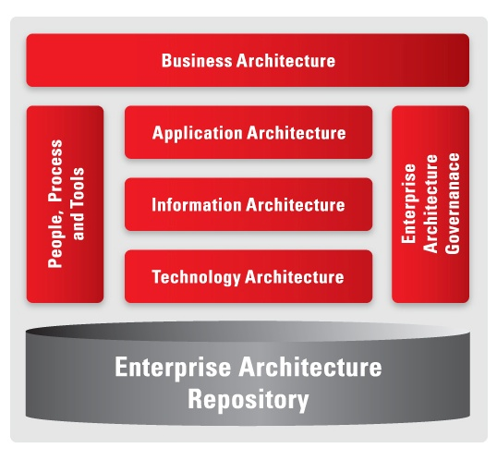

Oracle: How We Help
People
Process
Portfolio
Business Architecture
Governance
Architecture
Vision
Enterprise
Architecture
Repository
Roadmap
Current
State
Certified Architects,
Experienced Advisors
Future
State
Best Practices,
Proven Artifacts
Practical Approach,
Proven Methodology
Notes:
Oracle is prepared to help you on your transformations in Business, Applications, Information, Technology or Governance architectures.
People -- Experienced Enterprise Architects, Solution Architects. Our people have unmatched expertise in each Oracle product (depth), as well as unique experience across the entire Oracle portfolio (breadth).
Process - our proven methodology, and practical approach to Enterprise Architecture.
Portfolio of Enterprise Architecture artifacts, – including Oracle Reference Architectures
Our People – our Results – and our Innovation.

Slide 7
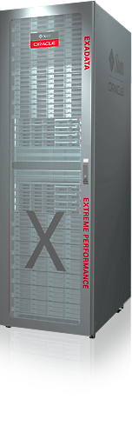

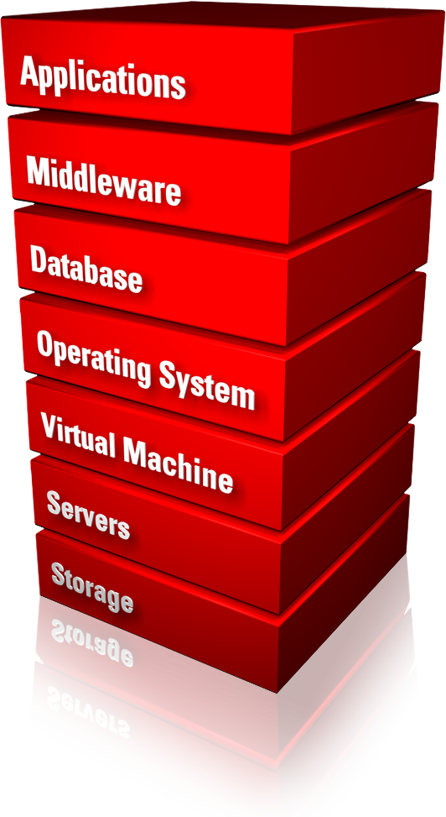
Oracle Customer Support Services
Enabling the
success of your Oracle software and hardware
investments through a
LIFECYCLE
OF SERVICES
covering the complete
Oracle stack
Notes:
Oracle Services are designed work together seamlessly with Oracle hardware and software products to enable the success of your Oracle investments - throughout your IT lifecycle - and across the complete Oracle stack.
7

Slide 8
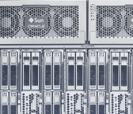


Oracle Services and Your Success
Focus
We focus exclusively on Oracle technologies
No one knows Oracle
better than Oracle
Experience
We have helped thousands
of customers optimize their Oracle investment
Let us use this experience
to help you
Leadership
Continuous investment in a unified support experience
No one else can service and support the entire stack
People
Our service personnel average tenure is over
eight years
No one can match our
skilled people
Notes:
So what does our investment mean for you. As a result of our exclusive focus on Oracle software and hardware technologies – as well as our 70+ acquisitions to date - we have a unique combination of diverse product knowledge as well as deep expertise. Our experience has helped thousands of customers across the globe optimize their Oracle investments. And only Oracle has the demonstrated executive leadership and investment in a unified customer support experience - across the entire stack – all backed by extremely skilled people with an average tenure of over eight years.
8

Slide 9

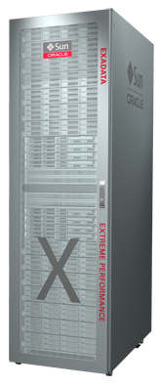

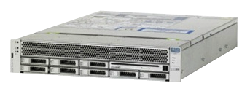
Oracle Premier Support
Complete Support for Oracle Software, Hardware and Solutions
Support for individual products
Support for field or factory-integrated solutions
PREMIER SUPPORT
FOR SOFTWARE
PREMIER SUPPORT
FOR SYSTEMS
COMPLETE
SOLUTION SUPPORT
Notes:
When selecting the hardware and software that runs your business, it’s important to consider the ongoing support and evolution of that IT solution. At Oracle, we believe that complete support is an essential element of customer success. Oracle Premier Support offers complete support for software, server, and storage investments. Our unique approach promotes consistent, high-quality support across all hardware and software assets, backed by unparalleled investment in product and service enhancements so you maintain business strength and competitiveness over time. And ultimately our simple, more integrated approach to enterprise IT support yields
better business results.
9

Slide 10



Oracle Premier Support
Comprehensive Coverage
Service and Support
Tools and Resources
Product Innovation
Quickly diagnose and resolve issues
Expert technical support
Rapid-response field service
Lifetime Support
Get the most of your Oracle products with proactive services
Oracle knowledgebase
Product health checks
My Oracle Support Community
Keep pace with change and capitalize on new opportunities
Updates
New releases
Tools to assist with patching and upgrades
Notes:
Oracle Premier Support provides our customers with all the essential support services you might expect:
1)Service and Support to diagnose and resolve issues
2)Oracle tools and resources to really get the most of you products, and
3)Innovation – through updates and upgrades to software and integrated software (such as firmware)
So, no surprises here, but it’s really in how Oracle approaches each of these areas – and the broader topic of support – where you can start to see the Oracle Support Advantage

Slide 11

Support Architecture
After Deployment: Giving Equal Attention to Successful Ongoing Operations
Availability
Performance
Proactive Maintenance
and
Rapid Resolution
Security
Lowest Cost

Slide 12

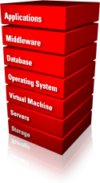
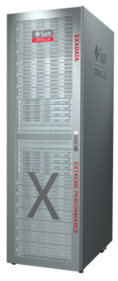






Support Strategy and Execution
Unified Support across the Complete Stack and Deployment Models
OPTIMIZED
SOLUTIONS
ENGINEERED SYSTEMS
SOFTWARE
HARDWARE
Unified Support
On-Premise Private Cloud Public Cloud Hybrid

Slide 13
Support Best Practices—Maximize Business Value
DISCOVER
Support Best Practices
ADOPT
My Oracle Support
MAXIMIZE
Premier Support Proactive Portfolio
Oracle Premier Support
Notes:
If your only interactions with Oracle Premier Support have revolved around Service Requests when problems occur, you are missing out on key capabilities that could play a role in contributing to your company’s success.
There is so much more to Oracle Premier Support than just opening Service Requests. Oracle Premier Support provides customers with support best practices, capabilities, and tools to help you work effectively with Oracle Support, increase adoption of My Oracle Support Portal and maximize business value by plugging into the Get Proactive portfolio.
During this presentation we will explore valuable information and Support Best Practices categorized under three sections – Discover | Adopt | Maximize.
Let’s get started.

Slide 14
Agenda
Oracle Services overview
Oracle Support major functionalities
News in Oracle Support

Slide 15
MOS Release Timeline
MOS is released every quarter:
  6.0: 27-Jan-2012
  6.1: 13-Apr-2012
  6.2: 13-Jul-2012
  6.3: 12-Oct-2012
  6.4: 11-Jan-2013
  6.5: 5-Apr-2013
  6.6: July 2013
  6.7: October 2013
  6.8: February 2014

Slide 16
6.0 New HTML UI for Customers
HTML Customer UI was re-written using Application Development Framework (ADF)
  Current HTML portal was be replaced.
  URL did not change.
  Main reason was re-usability of code for all portals.
  Accessibility requirements were be integrated.
  New HTML portal have slightly different features.

Slide 17
6.0 New HTML UI for Customers
Service Request:
  Simpler, faster, easier to user Service Request Create flow
  Three steps in total compared to 7
  Better organization of related content through the 3 steps
  One common flow for both hardware and software
  Ability to include information on both hardware and software in a Service Request
  Easier product and CSI selection
  Simpler hierarchical lists for Operating System, Database, etc.

Slide 18
6.2
Flash Customer Portal retirement

Slide 19
6.2 MOS Mobile
KM search, view, filter
CUA approve pending CSI, associate CSI to config, approve an asset

Slide 20
6.2 MOS Patches
Patch Plans, Upgrade Plans, Upgrade Assistant, including:
  Plans and Patch Requests Listing/Search
  Plans Integrations with Configurations
  Initiate Upgrade Plans from Configurations (Targets, Systems, Healthchecks, Inventory reports)
Patch Recommendations
  Integration with Configurations, PowerView, Master-Details, Local Filters, and Search

Slide 21
News in 6.3
Changes related to Platinum Support
Introduction of 24x7 flag
Modifications of Assets
  Present better asset information to the customer, improve entitlement, and create a system configuration view to provide better service to the customer.

Slide 22

Oracle Platinum Services
Extended Value with Oracle Engineered Systems
Further Reduces Risk and Operating Cost
Available for certified configurations running on
Exadata, Exalogic, and SPARC SuperCluster
No additional
cost under
Oracle premier support
24/7 Oracle monitoring
for database, middleware and systems via Oracle advanced support gateway
15 minute restoration or escalation to development
Patch
deployment
4 times per year (performed by Oracle according to a plan we create with you)

Slide 23
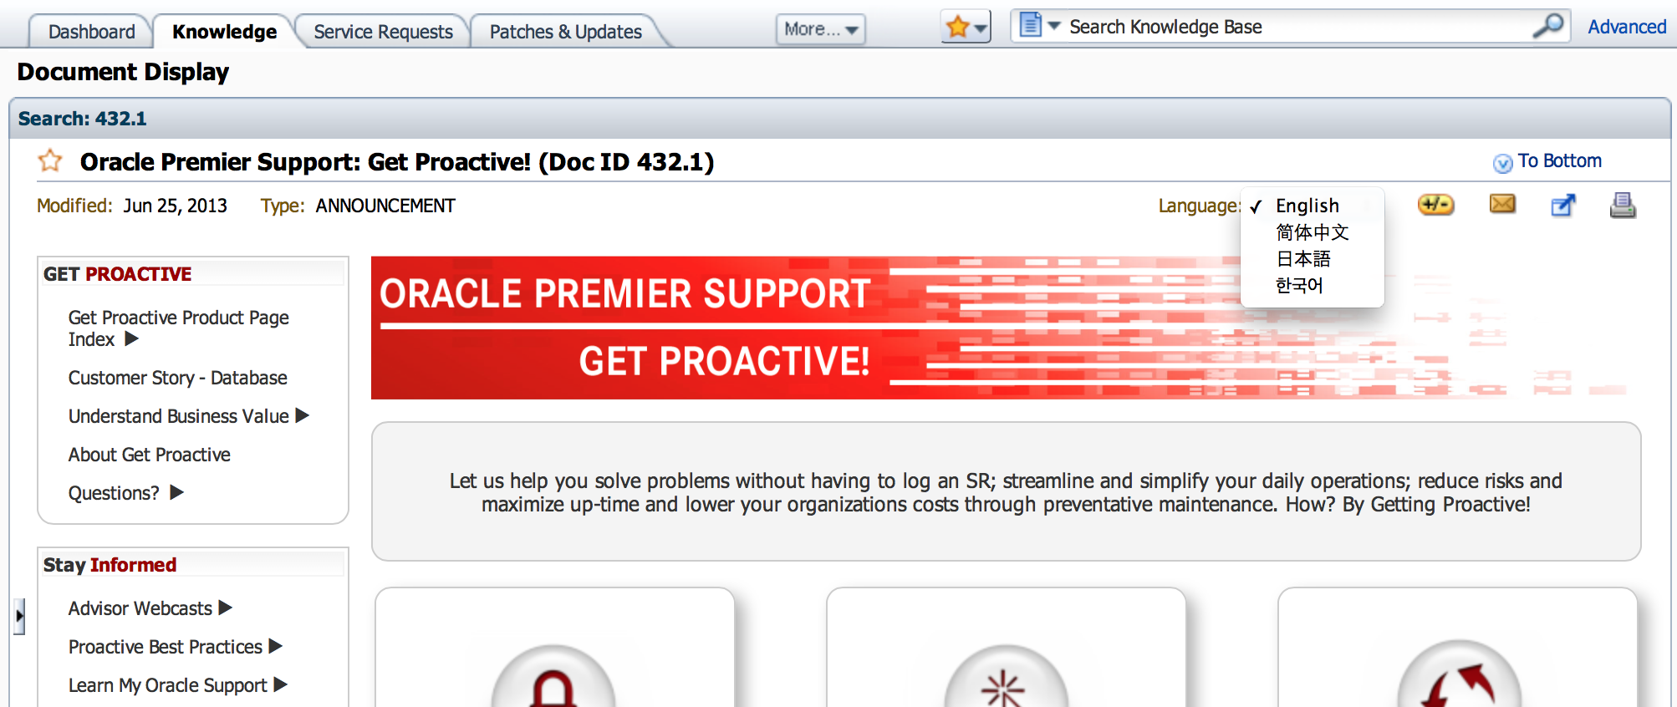
Knowledge Management
  Multi-Language Enhancements—External Customer/Partner View
Drop-down list shows when document has translations

Slide 24
6.5
Support Identifier Groups

Slide 25
Support Identifier Groups Usability Test
Few customers are testing it now
Most significant change in last few years
Support Identifier Group(s)
    for customers to manage their own CSIs, which will allow them to map assets and contacts inside MOS to customer created and maintained CSIs.
    Assets can be hardware or software from different contracts
    Contacts mapped to the new CSI will get service according to the underlying contracts

Slide 26
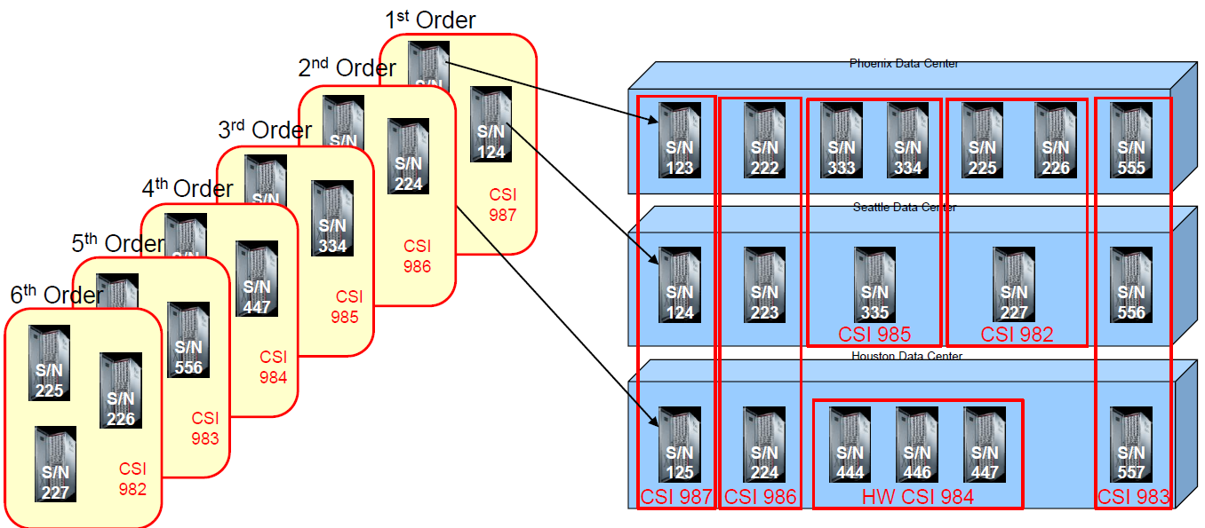
Support identifier groups
Current situation

Slide 27
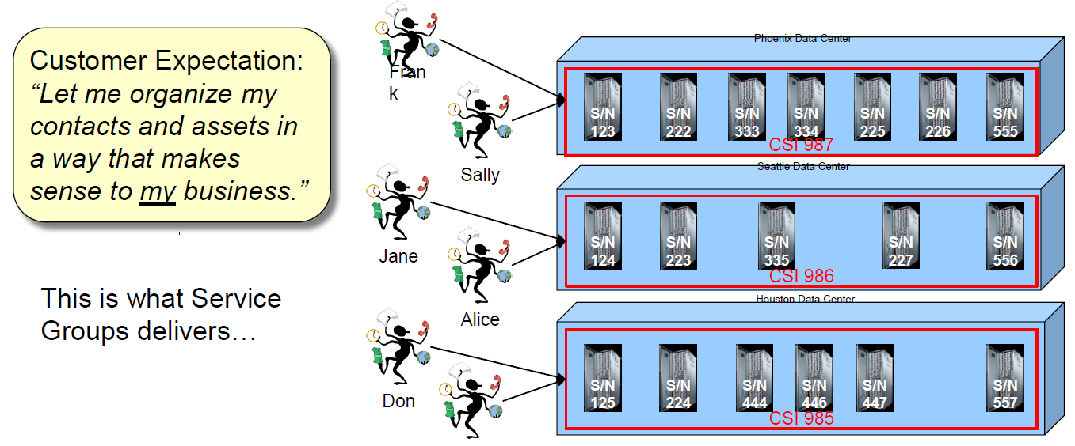
Support identifier groups
Future state

Slide 28
SR Colaboration
Engineer Initiated Customer Collaboration
  Paradigm shift for SR collaboration with our customers leveraging Oracle Social Network
Workflow
  Customer chooses to be available or not available for chat. This setting persists between MOS sessions.
  Engineer views an SR and an indicator shows them if any of the contacts for that specific SR are online/available
  Engineer initiates a chat session with the primary or alternate contact or both.

Slide 29
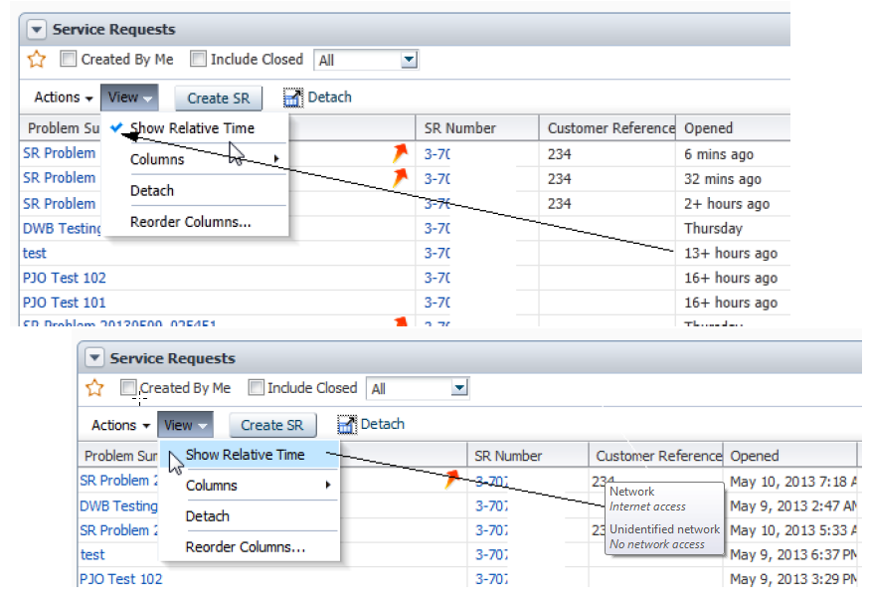
6.6
Time stamps on regions can be changed to present absolute time (May 10, 2013 8:34 AM) or relative time (+3 days ago)

Slide 30
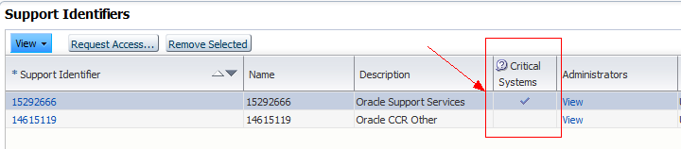
6.7
Critical Systems
  Customers can identify Support Identifier Groups that contain critical systems
  SRs created with the SIG will be identified as critical systems
  Oracle is aware of the SRs that impact their critical system

Slide 31
What to expect in future
Info not available

Slide 32

Notes:
In conclusion, Oracle’s hardware, software, and services are designed and tested as an integrated, end-to-end stack in order provide users with a complete, comprehensive solution, offering optimum functionality, top performance, and reduced complexity.
For more information on how Oracle Customer Services can enable the success of your Oracle hardware and software technologies please visit oracle.com

Slide 33
oracle.com/support

